Slide 1

Happy Tails Dog Rescue
CIS 5620 – Spring 2023
Annemarie Chin
Michael Torres

Slide 2
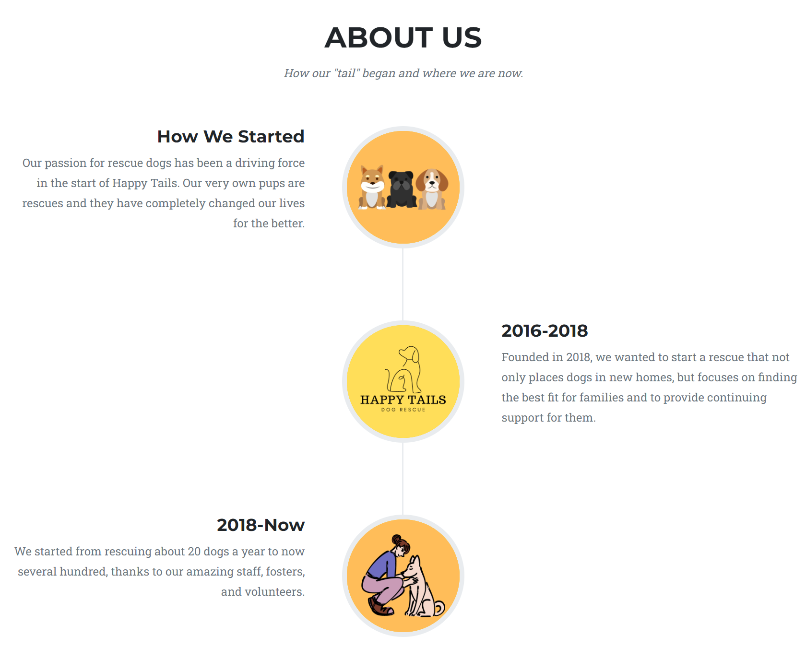
Who We Are

Slide 3
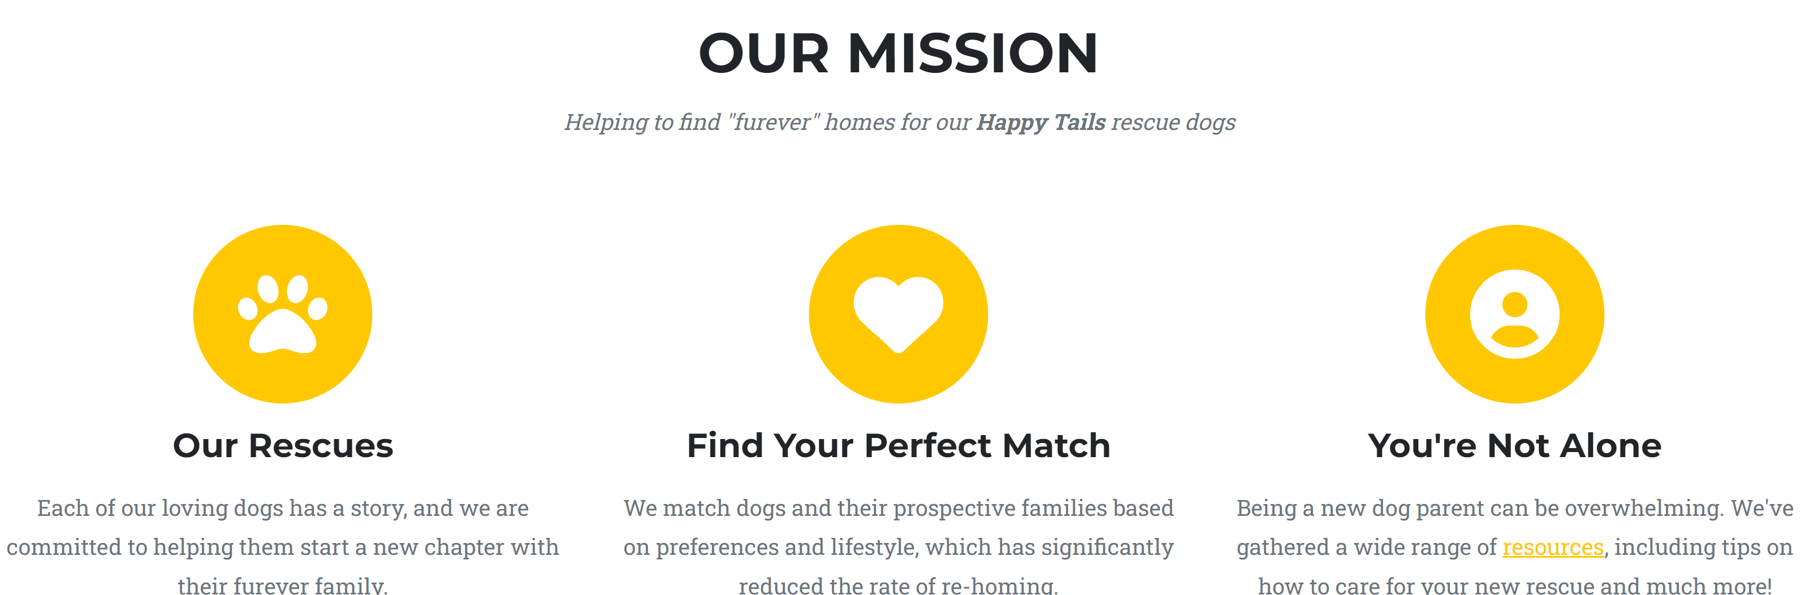

Slide 4
Project Objective & Value-Driven Purpose
Value: There is a huge untapped market of potential dog owners who could adopt instead of “shop” for a dog
Goal: To reach our target audience by building a website that showcases our rescue dogs so that they may find loving homes
Target Audience: Dog-loving people who are looking to adopt a dog that fits their preferences and lifestyle

Slide 5
How are dogs being adopted?
About 44% of households in the U.S. own a dog, yet only 23% of dogs are adopted from shelters and rescue organizations.
Source of Adoption | Percentage of Adopted Dogs
Animal Shelter/Humane Society | 23%
Friends/Relatives | 20%
Breeder | 34%
Stray | 6%
Private Party | 12%
Source: American Pet Products Association

Slide 6
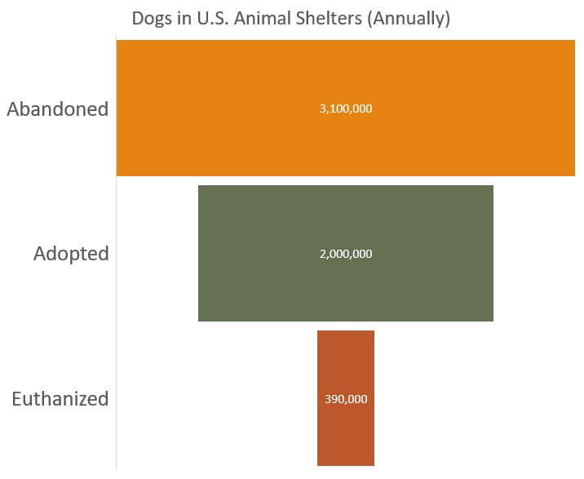
Shelters are at capacity
More dogs are being abandoned or surrendered than they are being adopted
1 in 10 pets who are adopted are returned to the shelter within six months.

Slide 7

Why are dogs being returned or abandoned?
Unexpected costs
Human health issues (ex. allergic to dogs)
Destructive behaviors
(ex. chewing furniture)
Disobedience
Excessive barking
Hyperactivity
Aggression
(ex. with children, family members, or pets)

Slide 8

Why should you be visiting Happy Tails Dog Rescue?
Browse our adoptable dogs
Each dog is listed with descriptive personality traits
See our success stories
Learn more about who we are
Message us to be matched with one of our dogs
Access to helpful resources

Slide 9
References
Pet Statistics (2019). American Society for the Prevention of Cruelty to Animals (ASPCA) website. Accessed on February 2023.
https://www.aspca.org/helping-people-pets/shelter-intake-and-surrender/pet-statistics
Avoiding Returning a Dog to the Animal Shelter (2022). Hill's Pet Nutrition, Inc. website. Accessed on February 2023.
https://www.hillspet.com/dog-care/new-pet-parent/common-reasons-adopted-dogs-are-returned-to-shelters?lightboxfired=true#
Our Animals (2023). Los Angeles County Animal Care & Control website. Accessed on February 2023.
https://animalcare.lacounty.gov/view-our-animals/
Need to find your pet a new home? (2023). Humane Society of the United States website. Accessed on February 2023.
https://www.humanesociety.org/resources/need-find-your-pet-new-home

Slide 10

Live Demo: https://anorton4.github.io/happytails/

